Slide 1
Chapter 14
Exception Handling and Event Handling

Slide 2
Chapter 14 Topics
Introduction to Exception Handling
Exception Handling in Ada
Exception Handling in C++
Exception Handling in Java
Introduction to Event Handling
Event Handling with Java

Slide 3
Introduction to Exception Handling
In a language without exception handling
  When an exception occurs, control goes to the operating system, where a message is displayed and the program is terminated
In a language with exception handling
  Programs are allowed to trap some exceptions, thereby providing the possibility of fixing the problem and continuing

Slide 4
Basic Concepts
Many languages allow programs to trap input/output errors (including EOF)
An exception is any unusual event, either erroneous or not, detectable by either hardware or software, that may require special processing
The special processing that may be required after detection of an exception is called exception handling
The exception handling code unit is called an exception handler

Slide 5
Exception Handling Alternatives
An exception is raised when its associated event occurs
A language that does not have exception handling capabilities can still define, detect, raise, and handle exceptions (user defined, software detected)
Alternatives:
  Send an auxiliary parameter or use the return value to indicate the return status of a subprogram
  Pass a label parameter to all subprograms (error return is to the passed label)
  Pass an exception handling subprogram to all subprograms

Slide 6
Advantages of Built-in Exception Handling
Error detection code is tedious to write and it clutters the program
Exception propagation allows a high level of reuse of exception handling code

Slide 7
Design Issues (continued)
How and where are exception handlers specified and what is their scope?
How is an exception occurrence bound to an exception handler?
Where does execution continue, if at all, after an exception handler completes its execution?
How are user-defined exceptions specified?

Slide 8
Design Issues
Should there be default exception handlers for programs that do not provide their own?
Can built-in exceptions be explicitly raised?
Are hardware-detectable errors treated as exceptions that can be handled?
Are there any built-in exceptions?
How can exceptions be disabled, if at all?

Slide 9
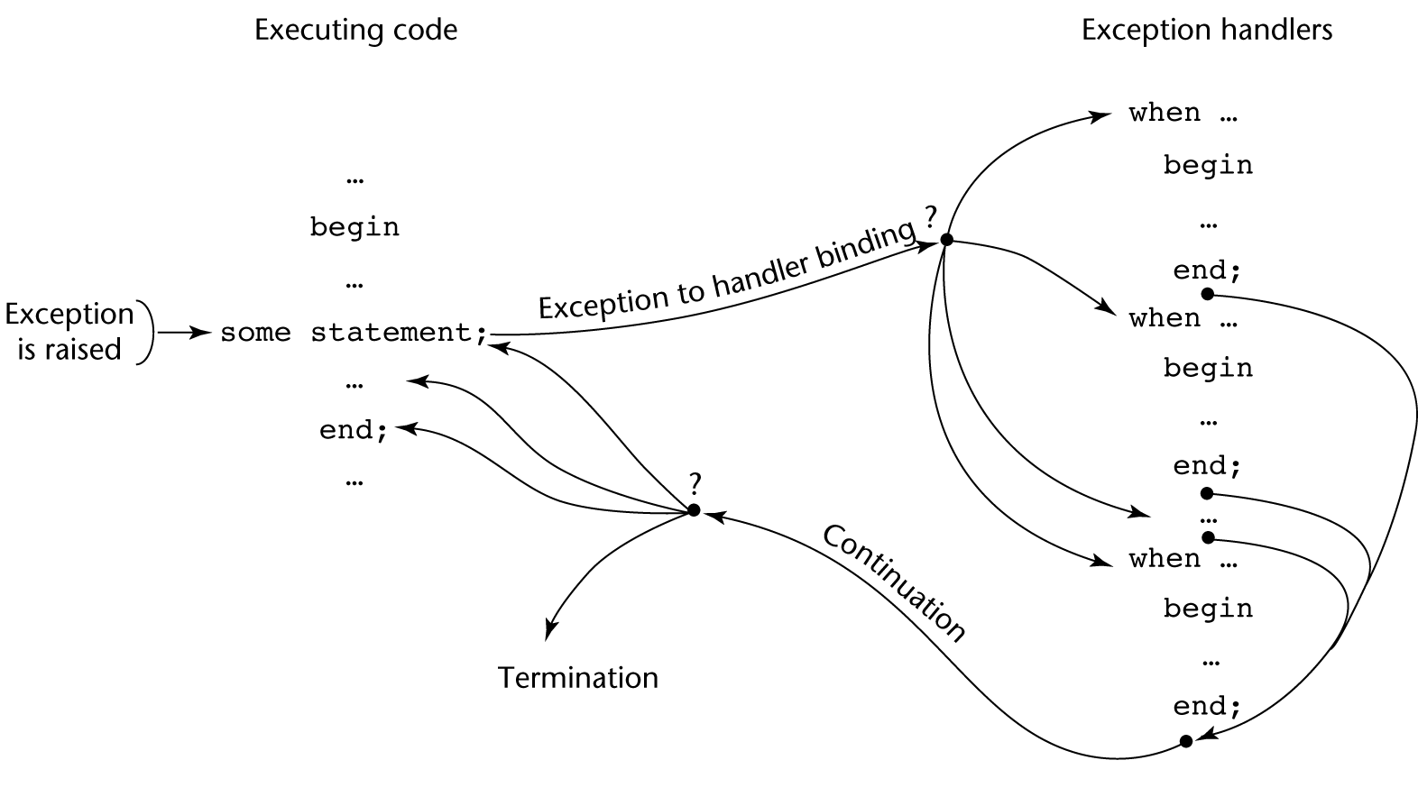
Exception Handling Control Flow

Slide 10
Exception Handling in Ada
An exception handler in Ada can occur in either a subprogram body, a package body, a task, or a block
Because exception handlers are usually local to the code in which the exception can be raised, they do not have parameters

Slide 11
Ada Exception Handlers
Handler form:
when exception_choice{|exception_choice} => statement_sequence
exception_choice form:
exception_name | others
Handlers are placed at the end of the block or unit in which they occur

Slide 12
Binding Exceptions to Handlers
If the block or unit in which an exception is raised does not have a handler for that exception, the exception is propagated elsewhere to be handled
  Procedures - propagate it to the caller
  Blocks - propagate it to the scope in which it appears
  Package body - propagate it to the declaration part of the unit that declared the package (if it is a library unit, the program is terminated)
  Task - no propagation; if it has a handler, execute it; in either case, mark it "completed"

Slide 13
Continuation
The block or unit that raises an exception but does not handle it is always terminated (also any block or unit to which it is propagated that does not handle it)

Slide 14
Other Design Choices
User-defined Exceptions form:
exception_name_list : exception;
Raising Exceptions form:
raise [exception_name]
  (the exception name is not required if it is in a handler--in this case, it propagates the same exception)
Exception conditions can be disabled with:
pragma SUPPRESS(exception_list)

Slide 15
Predefined Exceptions
CONSTRAINT_ERROR - index constraints, range constraints, etc.
NUMERIC_ERROR - numeric operation cannot return a correct value (overflow, division by zero, etc.)
PROGRAM_ERROR - call to a subprogram whose body has not been elaborated
STORAGE_ERROR - system runs out of heap
TASKING_ERROR - an error associated with tasks

Slide 16
Evaluation
The Ada design for exception handling embodies the state-of-the-art in language design in 1980
A significant advance over PL/I
Ada was the only widely used language with exception handling until it was added to C++

Slide 17
Exception Handling in C++
Added to C++ in 1990
Design is based on that of CLU, Ada, and ML

Slide 18
C++ Exception Handlers
Exception Handlers Form:
try {
-- code that is expected to raise an exception
}
catch (formal parameter) {
-- handler code
}
...
catch (formal parameter) {
-- handler code
}

Slide 19
The catch Function
catch is the name of all handlers--it is an overloaded name, so the formal parameter of each must be unique
The formal parameter need not have a variable
  It can be simply a type name to distinguish the handler it is in from others
The formal parameter can be used to transfer information to the handler
The formal parameter can be an ellipsis, in which case it handles all exceptions not yet handled

Slide 20
Throwing Exceptions
Exceptions are all raised explicitly by the statement:
throw [expression];
The brackets are metasymbols
A throw without an operand can only appear in a handler; when it appears, it simply re-raises the exception, which is then handled elsewhere
The type of the expression disambiguates the intended handler

Slide 21
Unhandled Exceptions
An unhandled exception is propagated to the caller of the function in which it is raised
This propagation continues to the main function
If no handler is found, the program is terminated

Slide 22
Continuation
After a handler completes its execution, control flows to the first statement after the last handler in the sequence of handlers of which it is an element
Other design choices
  All exceptions are user-defined
  Exceptions are neither specified nor declared
  Functions can list the exceptions they may raise
  Without a specification, a function can raise any exception (the throw clause)

Slide 23
Evaluation
It is odd that exceptions are not named and that hardware- and system software-detectable exceptions cannot be handled
Binding exceptions to handlers through the type of the parameter certainly does not promote readability

Slide 24
Exception Handling in Java
Based on that of C++, but more in line with OOP philosophy
All exceptions are objects of classes that are descendants of the Throwable class

Slide 25
Classes of Exceptions
The Java library includes two subclasses of Throwable :
  Error
    Thrown by the Java interpreter for events such as heap overflow
    Never handled by user programs
  Exception
    User-defined exceptions are usually subclasses of this
    Has two predefined subclasses, IOException and RuntimeException (e.g., ArrayIndexOutOfBoundsException and NullPointerException

Slide 26
Java Exception Handlers
Like those of C++, except every catch requires a named parameter and all parameters must be descendants of Throwable
Syntax of try clause is exactly that of C++
Exceptions are thrown with throw, as in C++, but often the throw includes the new operator to create the object, as in: throw new MyException();

Slide 27
Binding Exceptions to Handlers
Binding an exception to a handler is simpler in Java than it is in C++
  An exception is bound to the first handler with a parameter is the same class as the thrown object or an ancestor of it
An exception can be handled and rethrown by including a throw in the handler (a handler could also throw a different exception)

Slide 28
Continuation
If no handler is found in the try construct, the search is continued in the nearest enclosing try construct, etc.
If no handler is found in the method, the exception is propagated to the method’s caller
If no handler is found (all the way to main), the program is terminated
To insure that all exceptions are caught, a handler can be included in any try construct that catches all exceptions
  Simply use an Exception class parameter
  Of course, it must be the last in the try construct

Slide 29
Checked and Unchecked Exceptions
The Java throws clause is quite different from the throw clause of C++
Exceptions of class Error and RunTimeException and all of their descendants are called unchecked exceptions
All other exceptions are called checked exceptions
Checked exceptions that may be thrown by a method must be either:
  Listed in the throws clause, or
  Handled in the method

Slide 30
Other Design Choices
A method cannot declare more exceptions in its throws clause than the method it overrides
A method that calls a method that lists a particular checked exception in its throws clause has three alternatives for dealing with that exception:
  Catch and handle the exception
  Catch the exception and throw an exception that is listed in its own throws clause
  Declare it in its throws clause and do not handle it

Slide 31
The finally Clause
Can appear at the end of a try construct
Form:
  finally {
  ...
  }
Purpose: To specify code that is to be executed, regardless of what happens in the try construct

Slide 32
Example
A try construct with a finally clause can be used outside exception handling
try {
for (index = 0; index < 100; index++) {
…
if (…) {
return;
} //** end of if
} //** end of try clause
finally {
…
} //** end of try construct

Slide 33
Assertions
Statements in the program declaring a boolean expression regarding the current state of the computation
When evaluated to true nothing happens
When evaluated to false an AssertionError exception is thrown
Can be disabled during runtime without program modification or recompilation
Two forms
  assert condition;
  assert condition: expression;

Slide 34
Evaluation
The types of exceptions makes more sense than in the case of C++
The throws clause is better than that of C++ (The throw clause in C++ says little to the programmer)
The finally clause is often useful
The Java interpreter throws a variety of exceptions that can be handled by user programs

Slide 35
Introduction to Event Handling
An event is created by an external action such as a user interaction through a GUI
The event handler is a segment of code that is called in response to an event

Slide 36
Java Swing GUI Components
Text box is an object of class JTextField
Radio button is an object of class JRadioButton
Applet’s display is a frame, a multilayered structure
Content pane is one layer, where applets put output
GUI components can be placed in a frame
Layout manager objects are used to control the placement of components

Slide 37
The Java Event Model
User interactions with GUI components create events that can be caught by event handlers, called event listeners
An event generator tells a listener of an event by sending a message
An interface is used to make event-handling methods conform to a standard protocol
A class that implements a listener must implement an interface for the listener

Slide 38
Event Classes
Semantic Event Classes
  ActionEvent
  ItemEvent
  TextEvent
Lower-Level Event Classes
  ComponentEvent
  KeyEvent
  MouseEvent
  MouseMotionEvent
  FocusEvent

Slide 39
Summary
Ada provides extensive exception-handling facilities with a comprehensive set of built-in exceptions.
C++ includes no predefined exceptions Exceptions are bound to handlers by connecting the type of expression in the throw statement to that of the formal parameter of the catch function
Java exceptions are similar to C++ exceptions except that a Java exception must be a descendant of the Throwable class. Additionally Java includes a finally clause
An event is a notification that something has occurred that requires handling by an event handler

